Slide 1
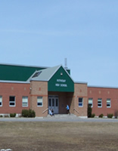
COURSE SELECTIONS
Entering Grade 11& 12
2022-2023
Rothesay High School

Slide 2
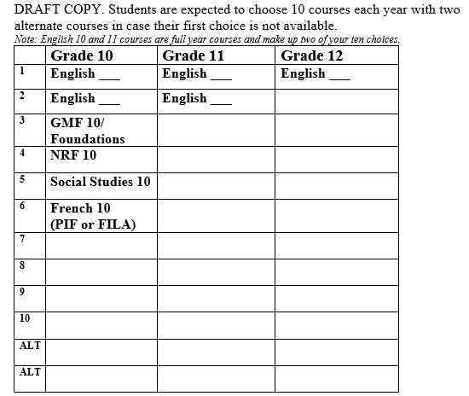
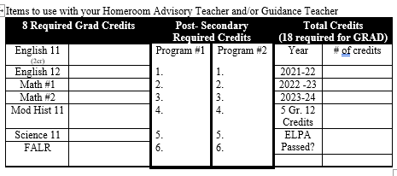
Education Planning Chart

Slide 3
Courses required for Graduation
3 English - English 11 (2 credits) & English 12 (1 credit)
2 Math - (NRF 10 + Foundations 110 OR Fin. Wrk. Plc. Math 110 , NBCC Wrk Ready Math 120)
1 Modern History
1 Science (Biology, Chemistry, Physics, Environ. Sc., Human Physiology, Intro to Electronics)
1 Fine Arts/Life Role: (Visual Arts, Music, Performing Arts, Creative Arts, Graphic Art and Design, Ind. and Family Dynamics, Co-op, Wellness Phys Ed.,Nutrition for Healthy Living, Entrepreneurship, Outdoor Pursuits, Tourism, Yoga, Culinary Tech, Shop Courses)
______________
8 COMPULSORY CREDITS
+10 OPTIONS
_____________
18 TOTAL
------------------------------------------------------------------------------------------------------------------
5 Credits must be at the Grade 12 Level
FI students: FILA 11 & 12 + 3 other FSL courses for FI Certificate
* Must Pass English Language Proficiency Assessment (ELPA)

Slide 4

FI students must take:
FI Language Arts (FILA) 110
FI Language Arts (FILA) 120
& THREE of the following:
FI Modern History 112/1
FI Foundations of Math 110
AP French Language and Culture *
FI Ind & Family Dynamics 110

Slide 5

FI Program Certificate of Completion
To receive an FI Program Certificate students must complete 5 French Immersion courses at the grade 11 and 12 level.
2 of these must be FILA 11 and 12
1 of these should be FI History 112

Slide 6
Course Levels
Level 1 = University prep (enriched)
Level 2 = University prep
Level 3 = College Prep
Level 0= General (No prerequisite)

Slide 7

Course Levels
Year
Yoga 110
Level

Slide 8

AP
(Advanced Placement) Program
This is a universal program that allows students to earn university credit pending the results of the AP exam

Slide 9
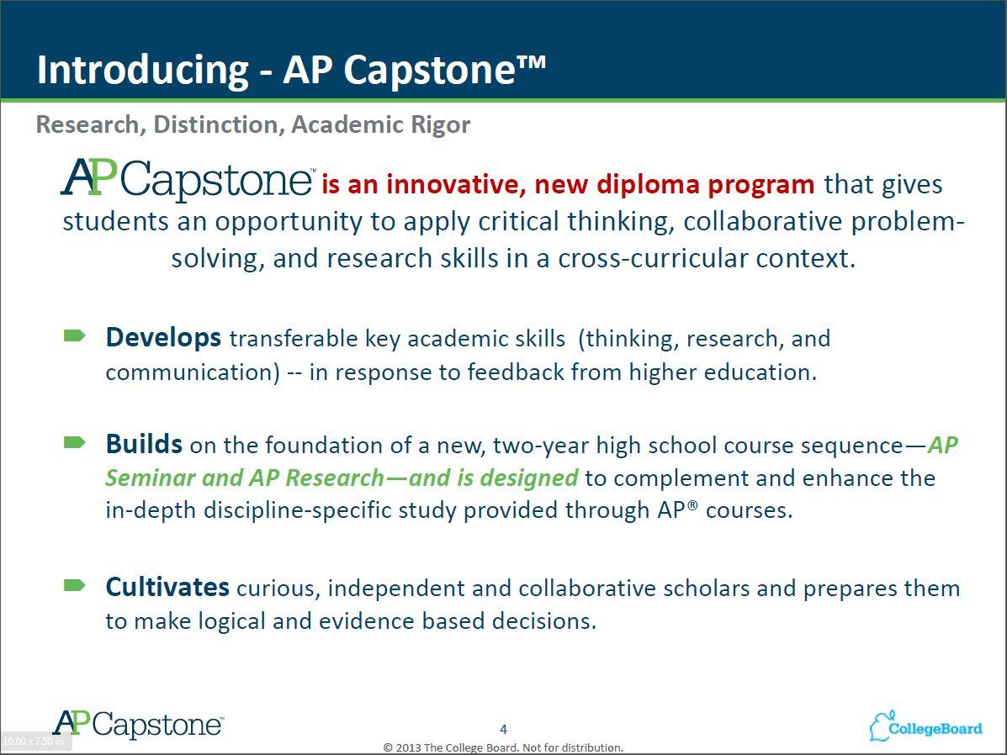

Slide 10
POSSIBLE AP CHOICES FOR 2022-2023
AP English Language and Composition
AP English Literature and Composition
AP Comparative Government and Politics
AP Psychology
AP Calculus AB
AP Biology
…this list continues to grow

Slide 11

How will you know what level to choose?
Teachers will recommend appropriate levels of study for you

Slide 12

Course Pre-Requisites
Keep in mind that you need to successfully complete some courses before you are able to take others……...
You need courses in Grade 10 to take some courses in Grade 11
Example:
You need Science 10 to take Bio 112
You need Art 9 or 10 to take Art 110…….
Other Grade 11 and 12 courses have prerequisites
Example:
You need Chemistry 112 to take Chem 122

Slide 13
Students in Grade 11 may take courses that begin with the number 12 – provided they have the pre-requisites for them.
Please remember that Grade 12 students MUST have 5 credits at the Grade 12 level to graduate.
Students in Grade 12 may take courses that begin with the number 11 – provided they have the pre-requisites for them.

Slide 14

YOU NEED TO REGISTER FOR
10 COURSES!

Slide 15

Students MUST complete two of the following Math courses for graduation:
NRF 10
Foundations of Math 110
Financial &Workplace Math 110
NBCC Sk Trd Wrk Ready Math 120 (Can be taken in grade 12)

Slide 16
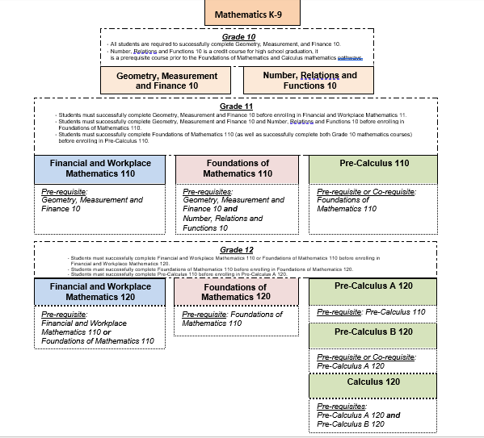

Slide 17

Current grade 10 students MUST register for a full year of English (2 credits):
English 111 (Lit. Text & Info. Text)
THIS IS AP SEMINAR
OR
English 112 (Lit. Text & Info. Text)
OR
English 113 (Lit. Text & Info. Text)

Slide 18
Current grade 11 students MUST register for a single credit of English 12 :
English 121
OR
English 122
OR
English 123

Slide 19

Students MUST complete 1 History course for graduation:
Modern History 112 or 111
FI Modern History 112 or 111(French Immersion program only)
Modern History 113

Slide 20

Students MUST complete 1 Science course for graduation:
Biology 112
Chemistry 112
Physics 112
Environmental Science 120
Human Physiology 110
Intro to Electronics 110

Slide 21




Grade 12 Science courses
Biology 122
Chemistry 122
Physics 122
Intro. to Environmental Science 120

Slide 22


Level 3 Science Options
Human Physiology 110
Intro to Electronics 110

Slide 23





Students must have ONE Fine Arts/Life Role
credit to graduate:
Graphic Art and Design 110
Phys Ed. Leadership 120
Performing / Theatre Arts 120
Hospitality and Tourism 110
Family Dynamics 120
Outdoor Pursuits 110
Entrepreneurship 110
Wellness 110
Yoga 110
Coop 120
Culinary Tech
Intro to Applied Tech
Mill & Cab

Slide 24

ELECTIVES
THE REMAINDER OF YOUR COURSES ARE ELECTIVES…
PLAN YOUR ELECTIVES CAREFULLY TO MAKE SURE THAT YOU HAVE THE COURSES YOU NEED WHEN YOU GRADUATE IN ORDER TO CONTINUE YOUR STUDIES…

Slide 25
Level 0 Courses:
Everyone can take:
Media Studies 120
Hospitality and Tourism 110
Entrepreneurship 110
Intro to Env. Science 120
Ind. & Family Dynamics 120
Culinary Tech 11/12
Performing Arts 120
More rigorous:
Law 120
World Issues 120
Sociology 120
Business Organization and Management 120
Political Science 120
Intro to Accounting 120
Recommended for ENGINEERING:
Computer Aided Design 110
Local Options (Max of 2)
Philosophy 120
Performing Arts 120

Slide 26

SOME COURSES REQUIRE APPLICATION FORMS:
Outdoor Education 110
Physical Education Leadership 120
Co-Op Education 120
Personal Interest 1 & 2
Forms will be distributed to students once COURSE SELECTION has been completed

Slide 27

Information for Application Deadlines:
GO TO HOMEROOM
Check the school website
You are responsible to apply ON TIME
Completed application forms must be submitted to the guidance Office (TBA)

Slide 28

Idea Centre
The IDEA (Innovation, Development, Entrepreneurship and Action) Centre program, facilitates student learning in the fields of entrepreneurship and community action.
This course is a unique leadership opportunity for motivated high school students seeking a challenge and craving the opportunity to take their ideas beyond the walls of the school. The program develops student-led projects with support from local entrepreneurs and social innovators.

Slide 29


Idea Centre
This program takes place in SJ. Transportation to SJ is provided, however students are responsible for their transportation home.
The program outcomes are designed to fill credit requirements for any two credits from the following courses: Co-Op 120, Economics 120, Entrepreneurship 110, Business Organization Management 120, or Leadership 120

Slide 30

Distance Education
The distance learning program offers several high school courses at the grade 11 & 12 level. Students take courses as part of their regular schedule, from the school, under the supervision of a local facilitator.
Online courses are taken by students for all kinds of reasons, including:
  Personal interest and choice
  Additional selection of courses
  Students want to experience online learning before university and post-secondary

Slide 31

What does it take to succeed in an online course?
Interest in the course and a desire to succeed.
Students must be independent, they work at their own pace, but it’s important to be persistent.
Be able to work through problems.
Time management
Communicate effectively with their online teacher and course facilitator.
Willing to develop basic technology skills.

Slide 32

TO SUMMARIZE…..
You are selecting 10 courses and 2 alternates
You need 18/21 courses to graduate
5 must be at the Gr.12 level

Slide 33

Planning
You need to look beyond graduation
If you know where you’re going, you will pick the right courses from the beginning
We have had some students realize that they don’t have what they need to get into University or Community College… and stay an extra semester or year… or even come back a couple of years down the road.

Slide 34
Post-secondary admissions information:
NBCC https://nbcc.ca/programs-courses/full-time-programs
UNB https://www.unb.ca/admissions/requirements/
STU https://www.stu.ca/admissions/
ACADIA https://admissions.acadiau.ca/ugguidelines.html
DAL https://www.dal.ca/admissions/undergraduate/hs_applicants.html
STFX https://www.stfx.ca/admissions/requirements
U de M: https://www.umoncton.ca/conditions
SMU: https://www.smu.ca/future-students/cs-admission-requirements.html

Slide 35
Courses required for Graduation
3 English (English 11 and 12)
2 Math
1 Modern History
1 Science (Biology, Chemistry, Physics, Environ. Sc., Human Physiology, Physical Geography)
1 Personal Development (Visual Arts, Music, Theatre Arts, Family Dynamics, Co-op, HPE 12, Entrepreneurship, Outdoor Pursuits, Tourism, Yoga, Wellness, Graphic Art, Culinary Tech, Shop Courses)
______________
7 COMPULSORY CREDITS
+10 OPTIONS
_____________
18 TOTAL
• 5 Credits must be at the Grade 12 Level
• Must Pass English Language Proficiency Assessment (ELPA)

Slide 36

WHERE CAN I GET MORE INFORMATION?
  Course Calendar -> RHS Website
University and College Admission Requirements (Online)
Talk with your Guidance Counselor
MyBlueprint.ca
Talk with your Teachers
Talk with your Parents

Slide 37

REGISTRATION DAY: MARCH 23
Snap a pic of your completed course selection form as a backup!
Completed Course Request form must be signed by a parent/guardian and handed in to your English teacher by March 23.
Students will enter their course selections into PS in HR on this day.

Slide 38
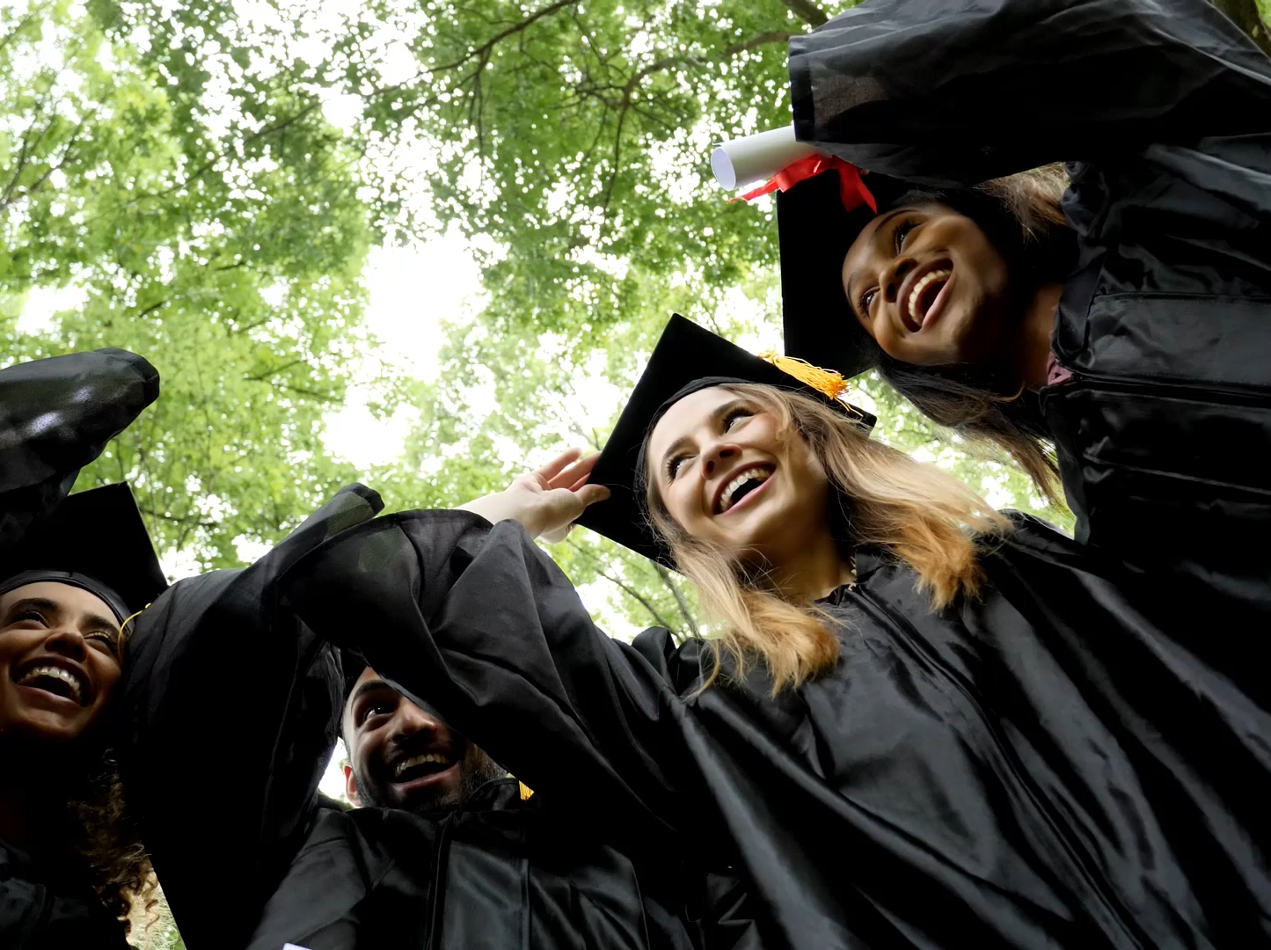
Admissions and Scholarship Myth Busting…

Slide 39

HOW IS MY AVERAGE CALCULATED?
Universities are only looking at required courses for entrance and top marks for the remaining elective(s).
Colleges are only looking to see that you have successfully completed the required courses for entrance. (Profile A= HS diploma or equivalent)
Outside scholarships and bursaries- specific criteria and seldom marks alone.
How does RHS calculate my average? We drop the lowest mark

Slide 40

GUIDANCE COUNSELLOR
Janice.jordan@nbed.nb.ca
Available to answer your questions

