Slide 1

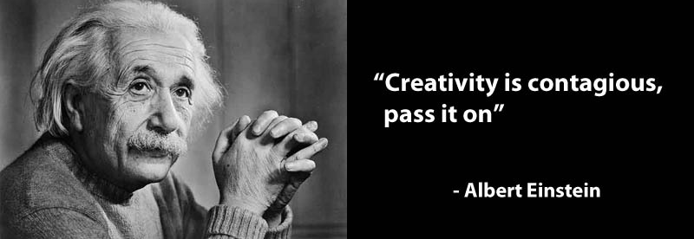


Visual Arts
At Sussex Regional High School

Slide 2
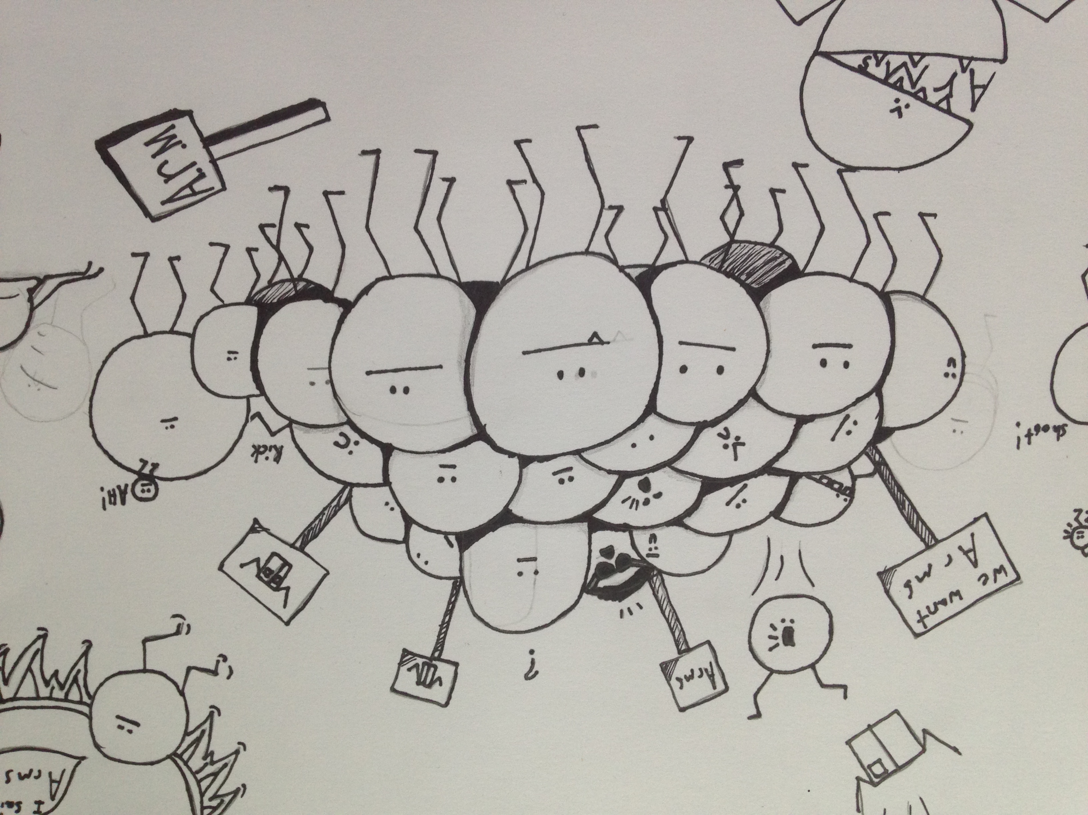
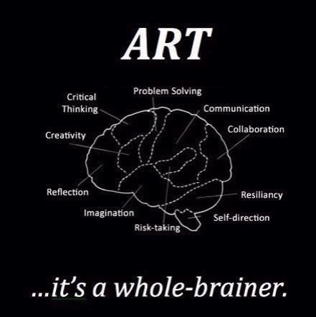
Art Nine and Art Ten

Slide 3

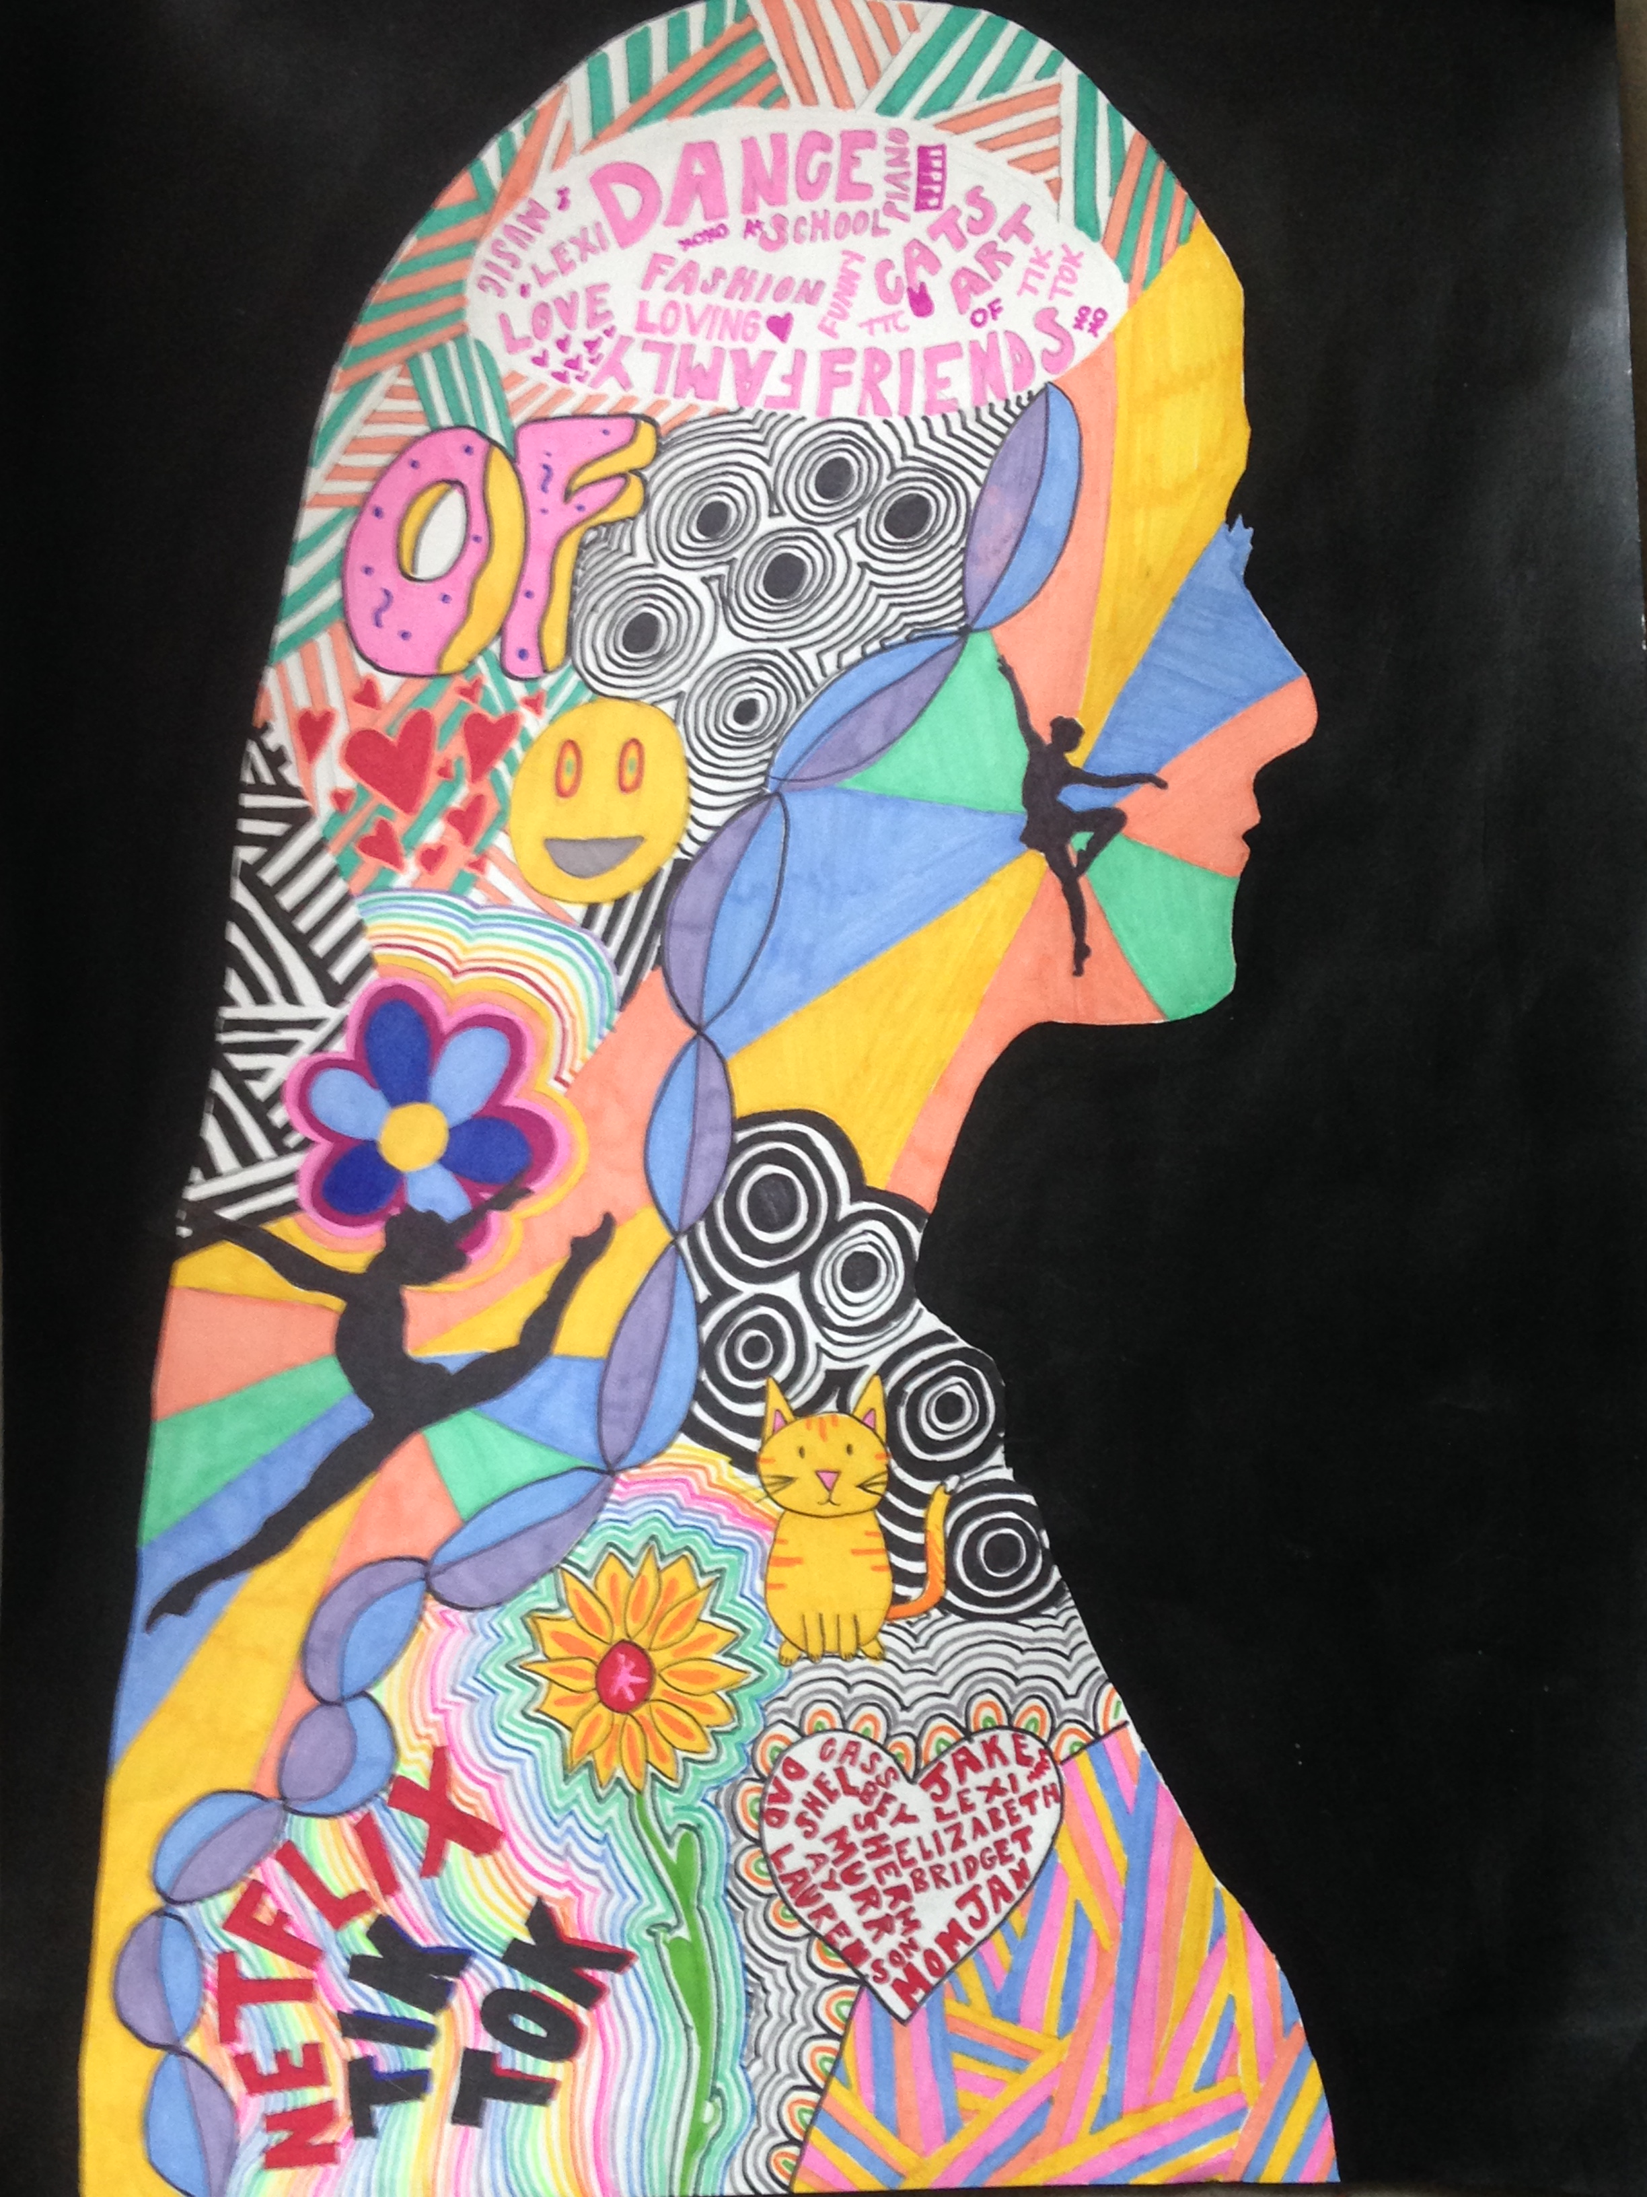
Some things you will learn
Sketchbook provided for Grade Nine Students
Elements of Design – Learn how to use line, colour, shape, space, form, texture and value.
Learn to use a variety of materials: markers, pencil, watercolour paint, acrylic paint, and 3D materials for sculpture.
Learn the basics of portrait drawing
Try your hand at cartooning

Slide 4
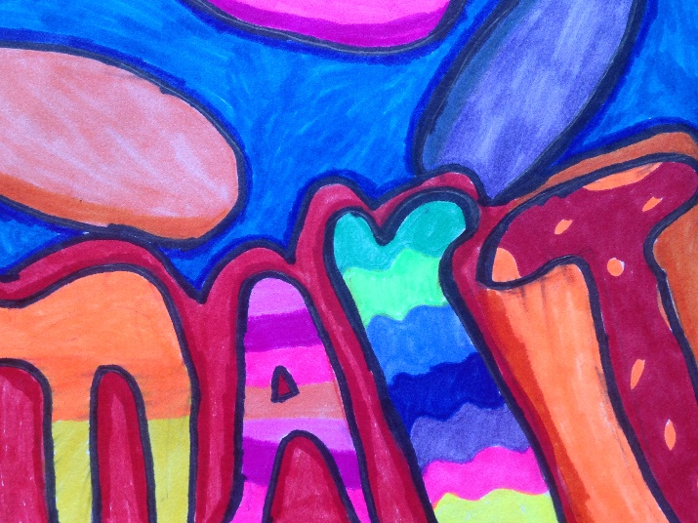
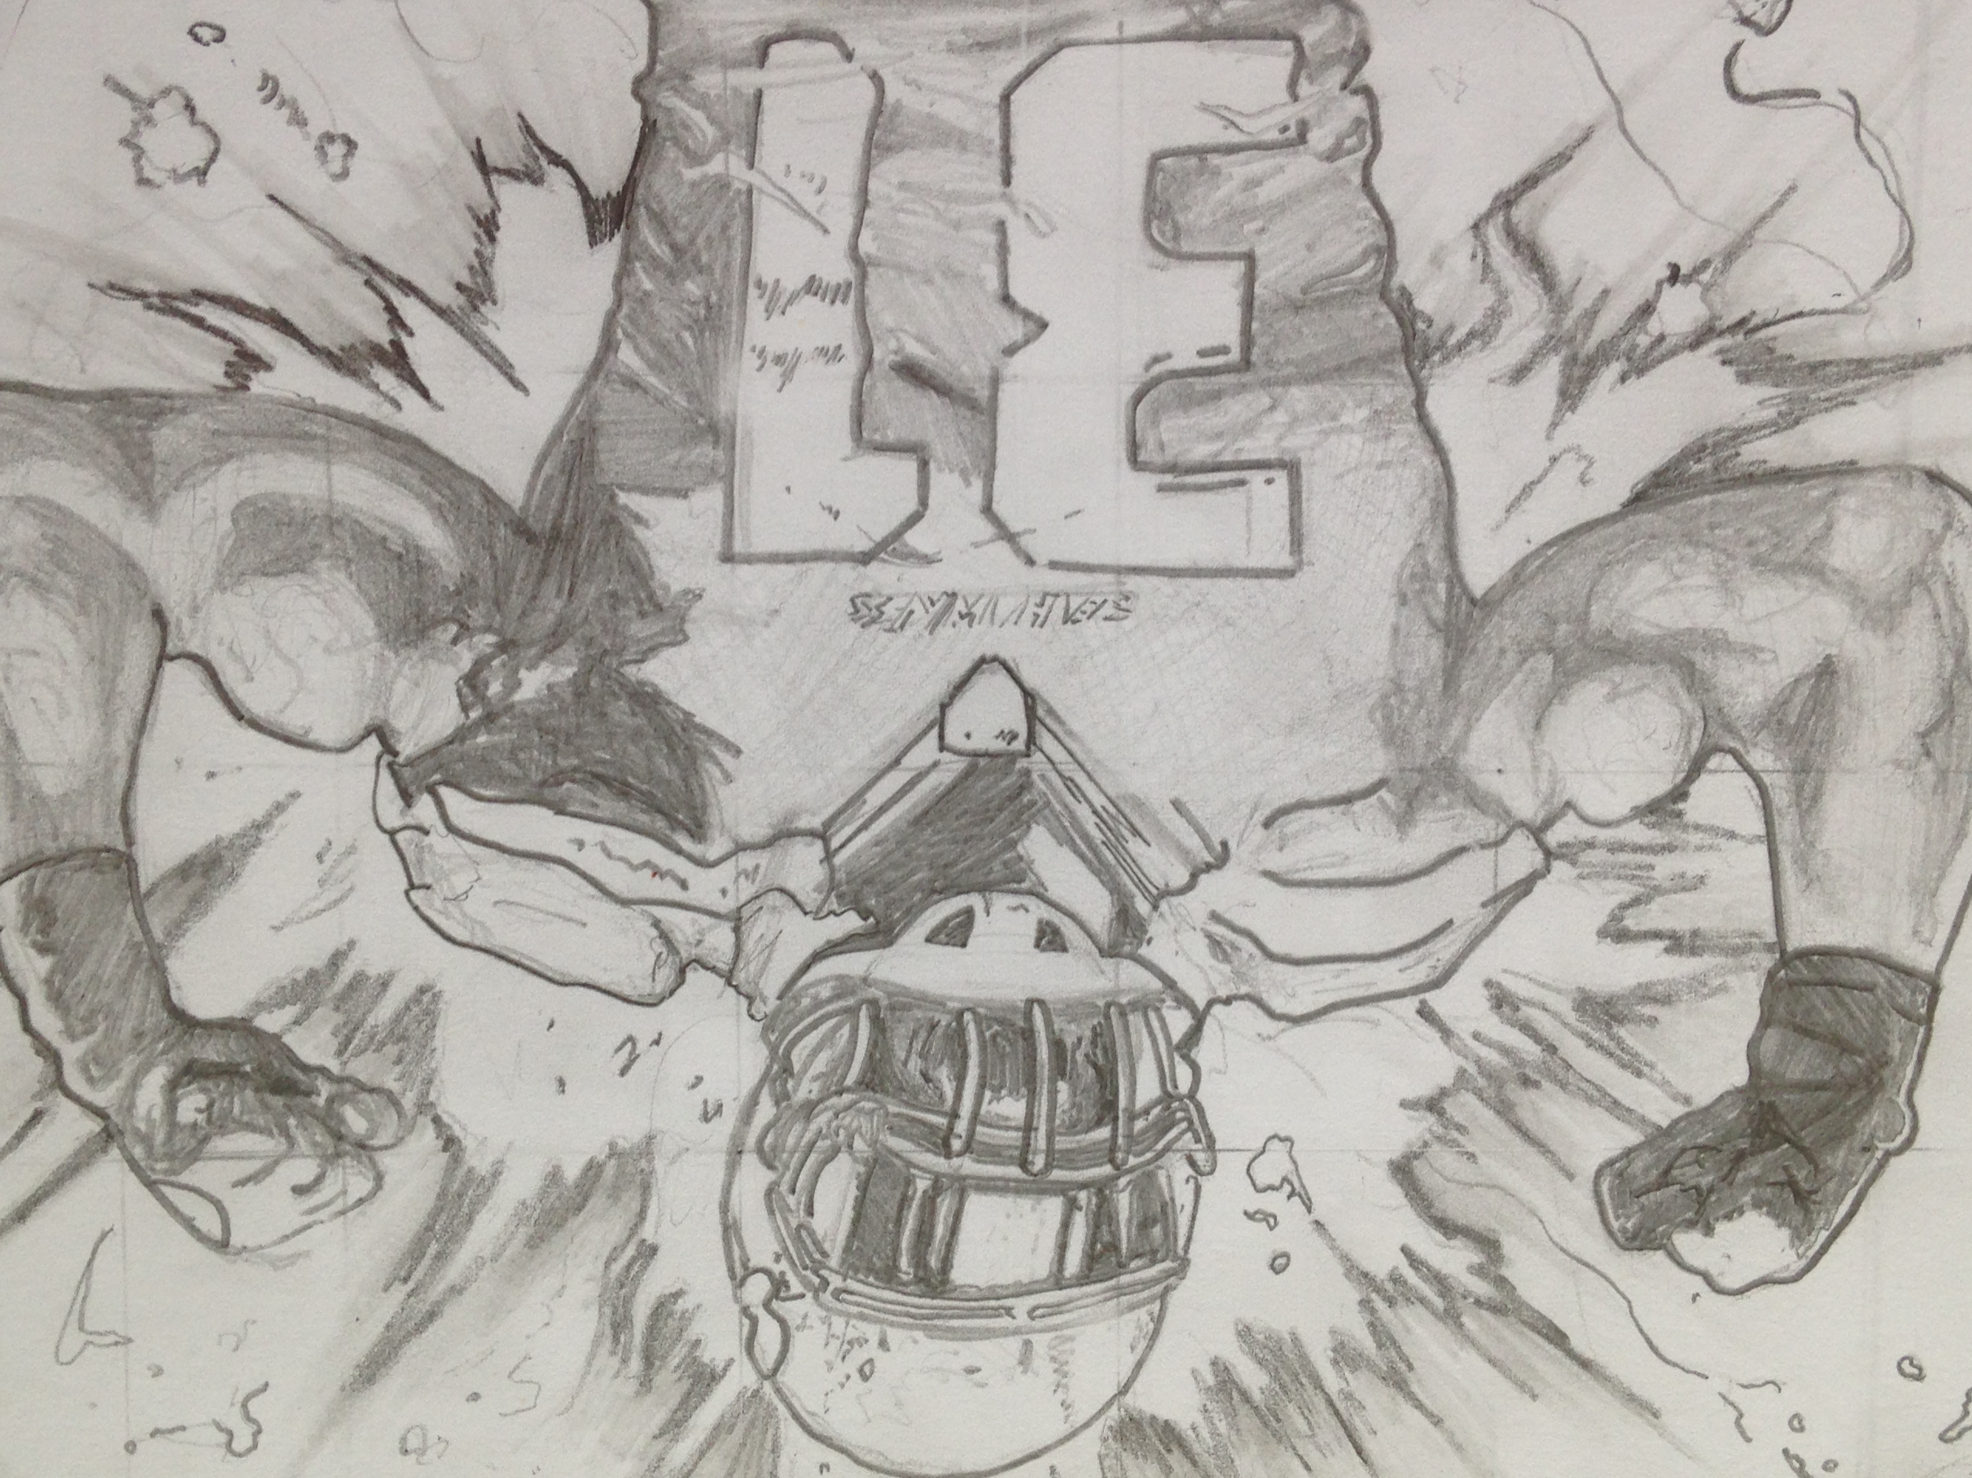
Some more things you will learn
Realistic drawing – using observation of real life and of reference photos to create something amazing.
Abstraction – take something from real life and make it difficult to recognize by changing the colours, shapes, etc.
Art History – learn about famous artists

Slide 5
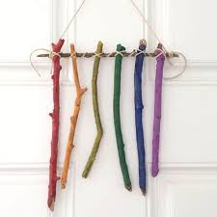

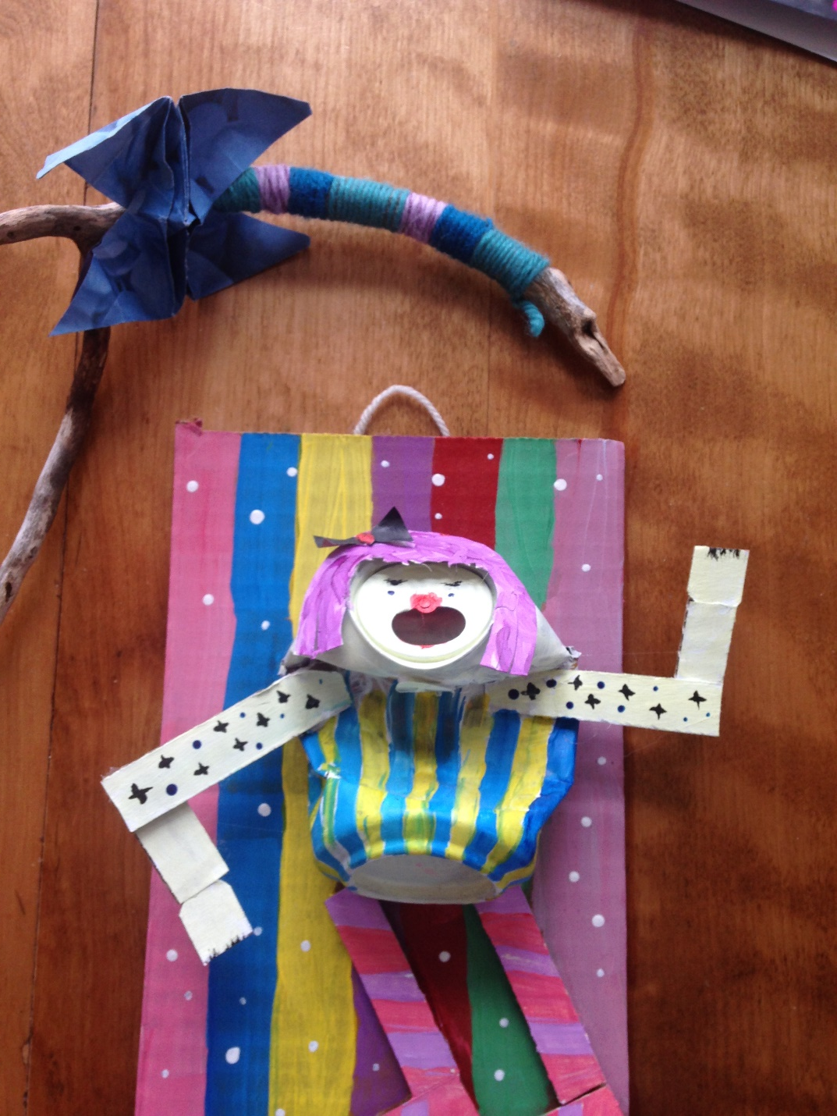
Even more … Sculpture
3-D Thursday
Once a week, we create something three-dimensional using materials like tinfoil, paper, pop cans, etc.

Slide 6
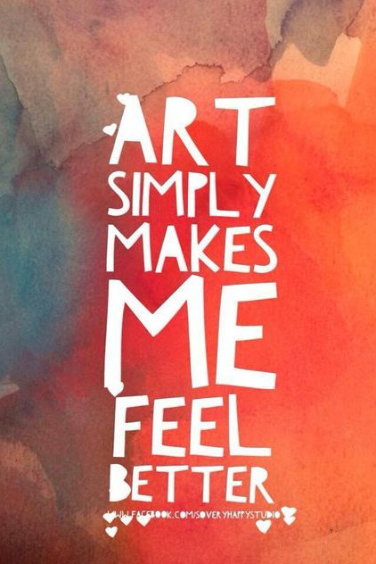
Visual Art 110
Find Your Style

Slide 7
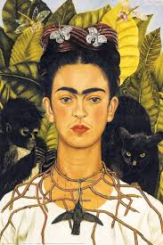
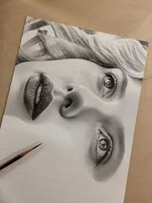
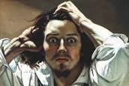
Visual Art 110
In this course, you will continue to develop:
your understanding of the elements and principles of art
your realistic drawing skills
an appreciation for art history

Slide 8
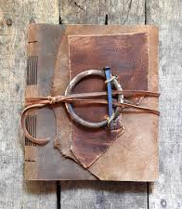
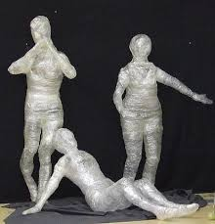
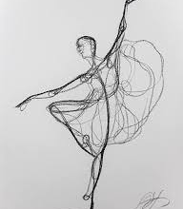
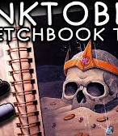
Visual Art 110
New Things You will Learn:
How to draw the human figure in correct proportion using a variety of techniques
How to create a sculpture using clay or packing tape
How to create illustrations for an Inktober sketchbook
How to create your own sketchbook (cover, binding, etc.) from scratch to display your work.

Slide 9
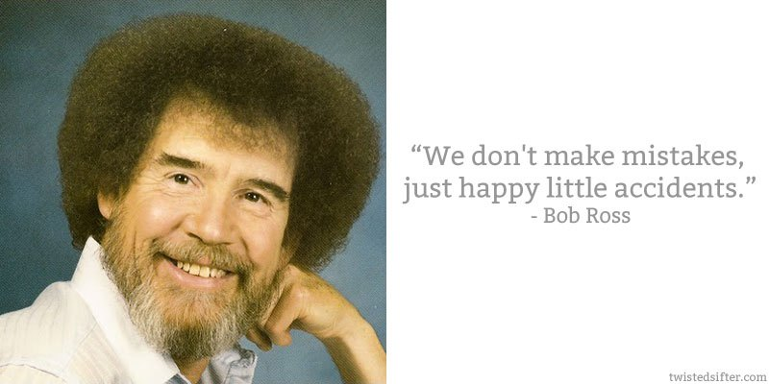
Visual Art 120

Slide 10
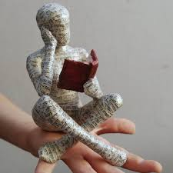
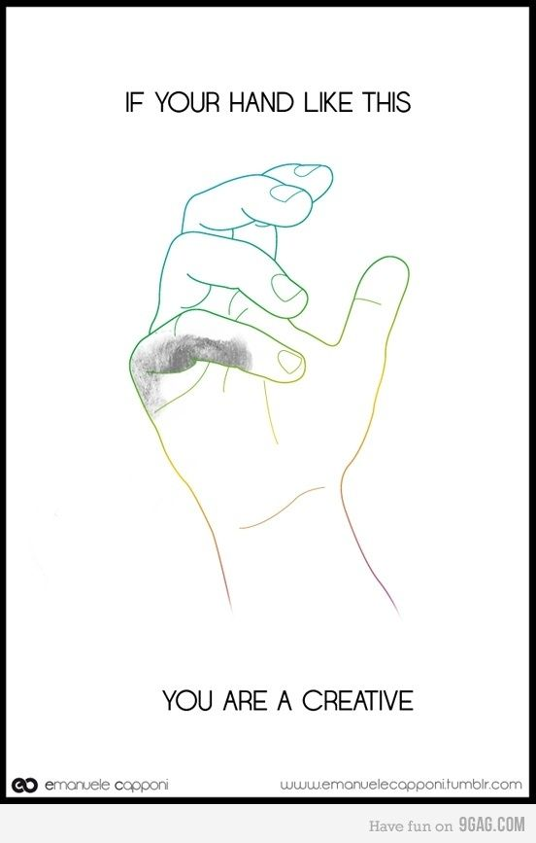
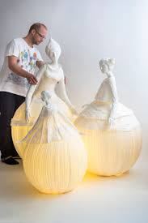
In Visual Art 120, you will have:
- The opportunity to develop your interest in art by using the materials of your choice: acrylic paint, linocut prints, watercolour, ink, etc.
- a chance to express yourself by creating a self-portrait series
- the chance to build a large paper mache sculpture

Slide 11

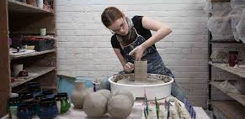
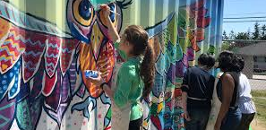
Contribute to Your Community
In Visual Art 120, you have many choices:
Create an artwork that will make a contribution to your school or community
Visit our local gallery
Contribute to an exhibition
Work on a portfolio you can use to apply for art school
Pursue your passion

Slide 12
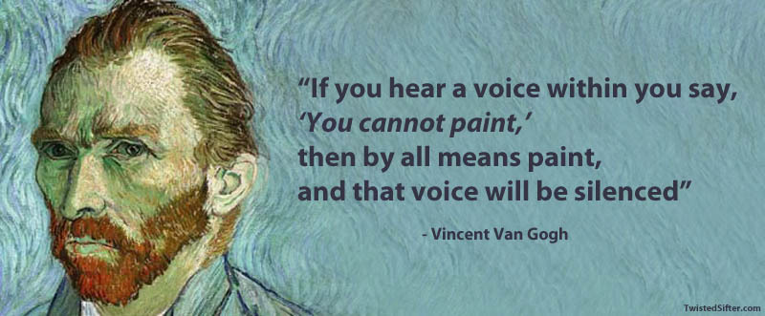
Hope to See you Next Year!

