Slide 1
Applied Technology & Skilled Trades
Course Selection Presentation

Slide 2
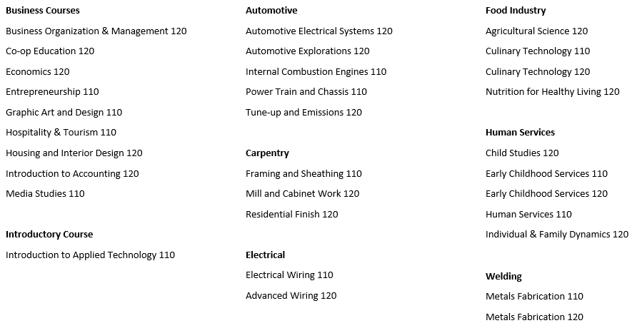
List of Course We Can Offer

Slide 3
Are you thinking about Business?
Business Organization and Management 120
Entrepreneurship 110
Introduction to Accounting 120
Graphic Art and Design 110
Media Studies 110
Economics 120

Slide 4
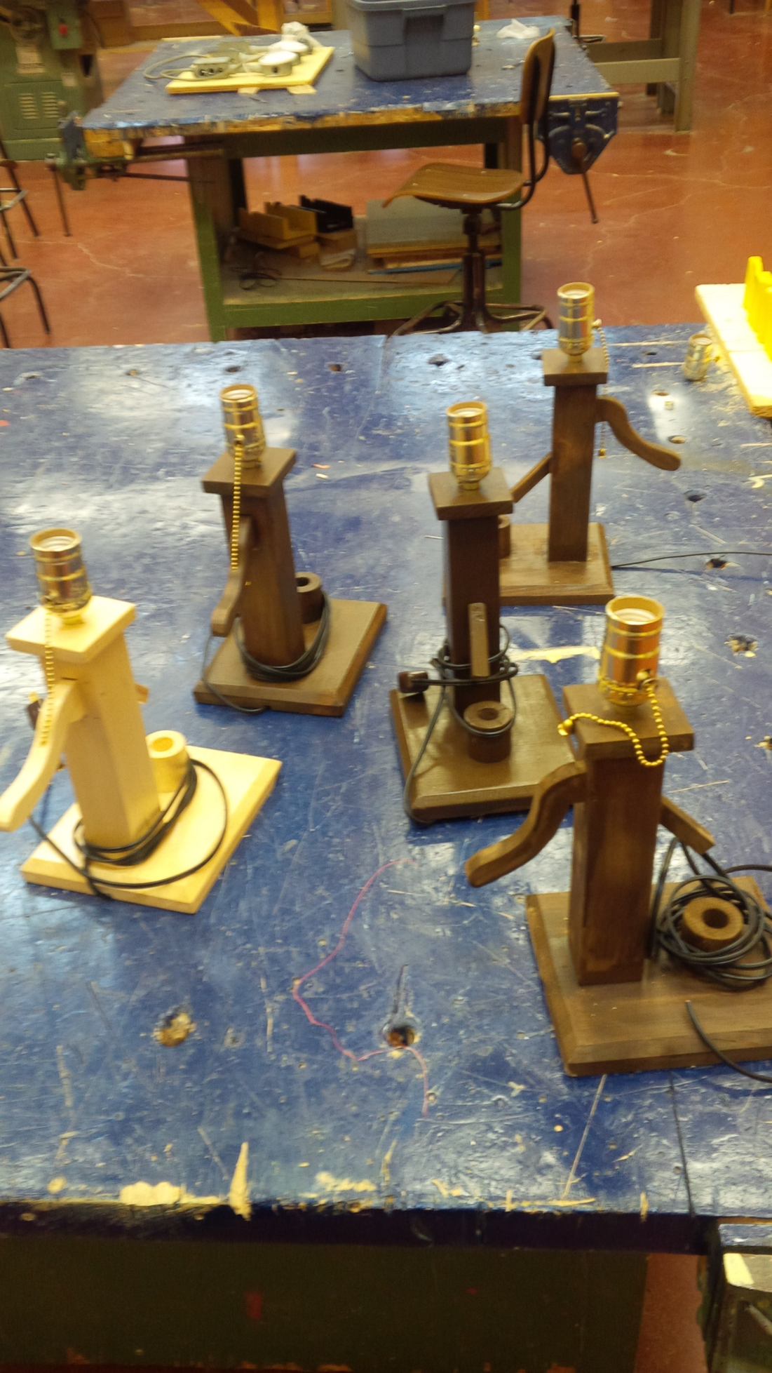
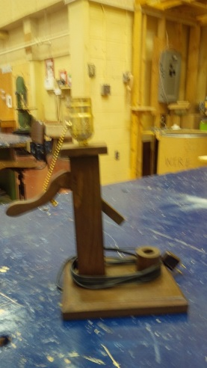
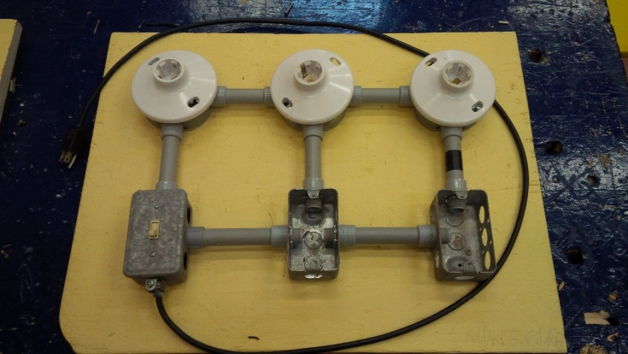
Do the trades seem to match your interests and your strengths? You can find out in this course:
Intro to Applied Tech 110
Notes:
Great introductory course to explore several of our course offerings; carpentry, electrical, plumbing and drafting.
Advanced Tech looks at the advances in technology with design; environmental concerns, energy efficiency, sustainability and teamwork.

Slide 5
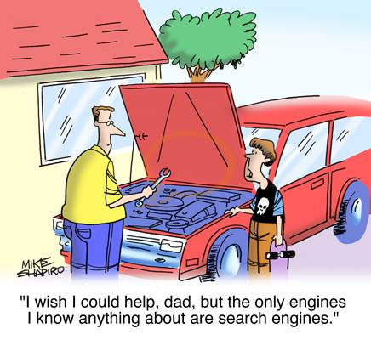
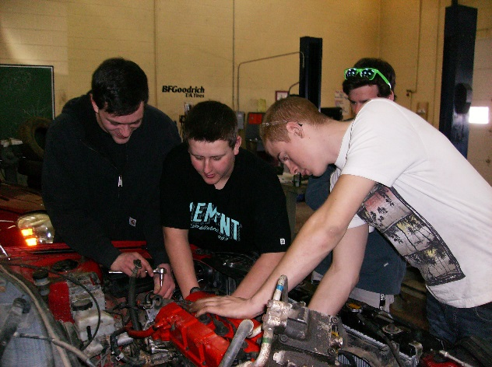
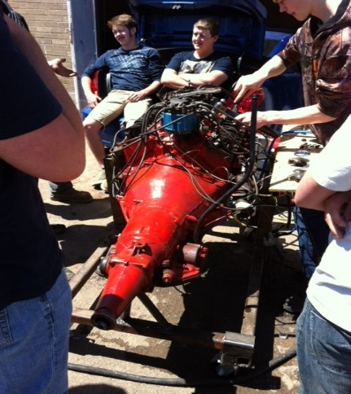
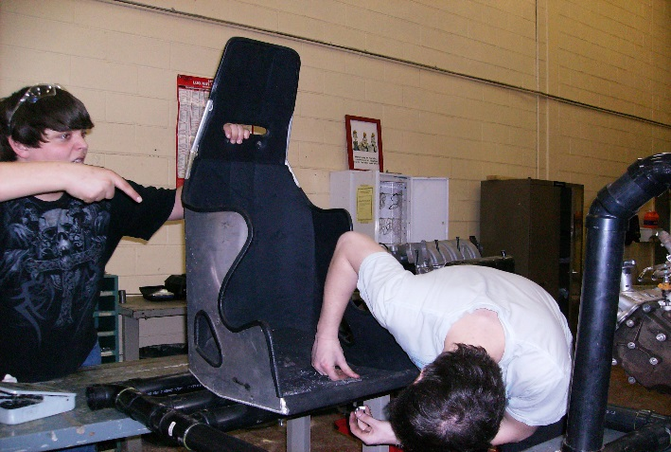
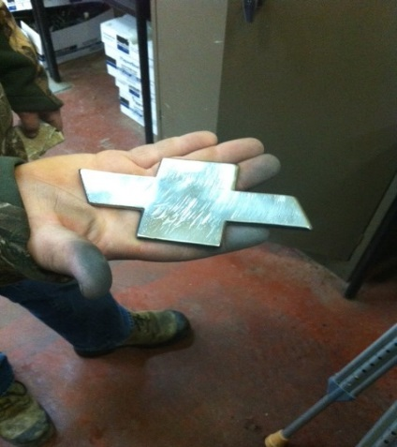
Automotive Industry?
Automotive Electrical Systems 120
Automotive Exploration 120
Internal Combustion Engines 110
Power Train and Chassis 120
Tune-up and Emissions 120

Slide 6
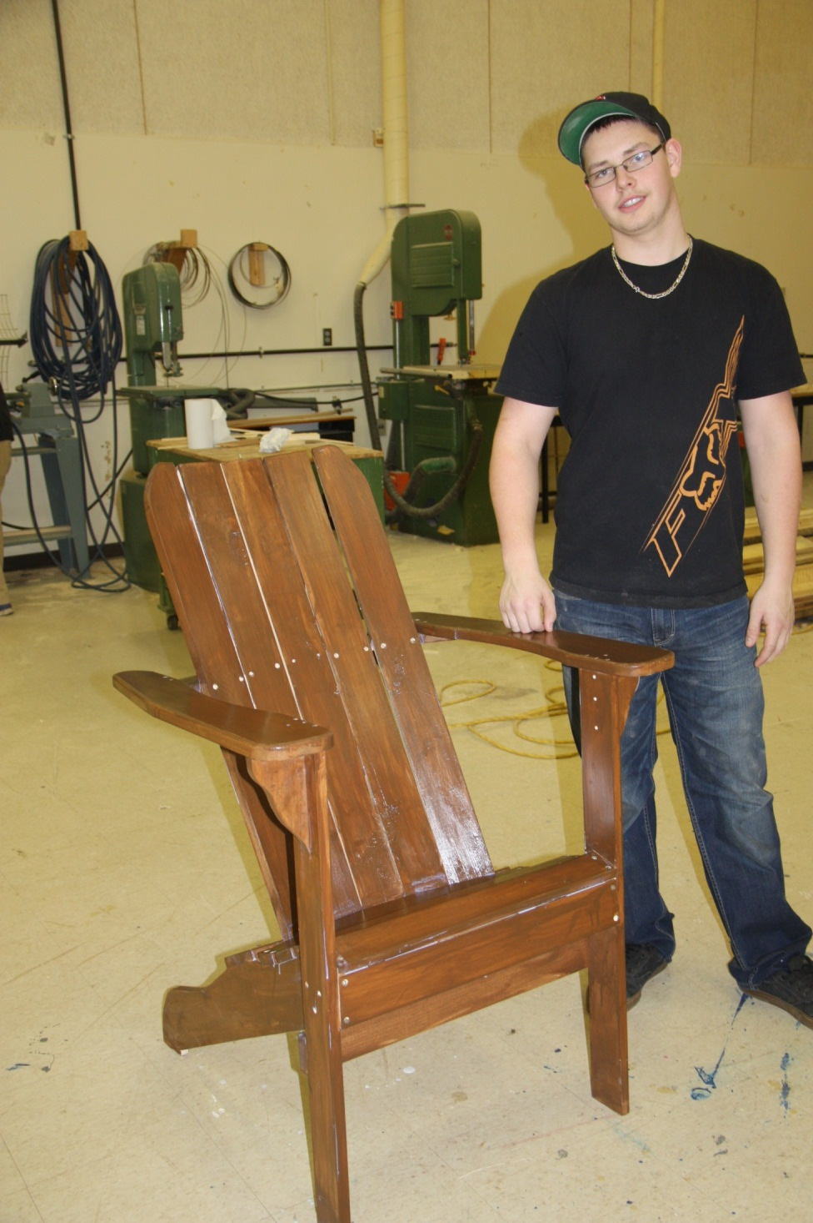
Carpentry?
Framing and Sheathing 110
Mill & cabinet 120
Residential Finish 120

Slide 7
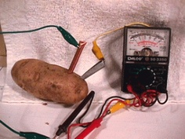
Electrical?
Welding?
Advanced Wiring 120
Electrical Wiring 110
Metals Fabrication 110
Metals Fabrication 120

Slide 8
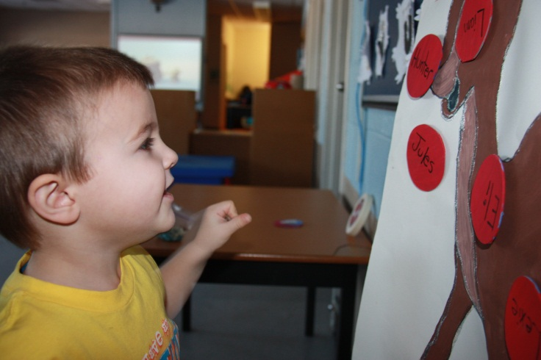
Perhaps you’re interested in a helping profession
Child Studies 120
Early Childhood Services 110
Early Childhood Services 120
Human Services 110

Slide 9
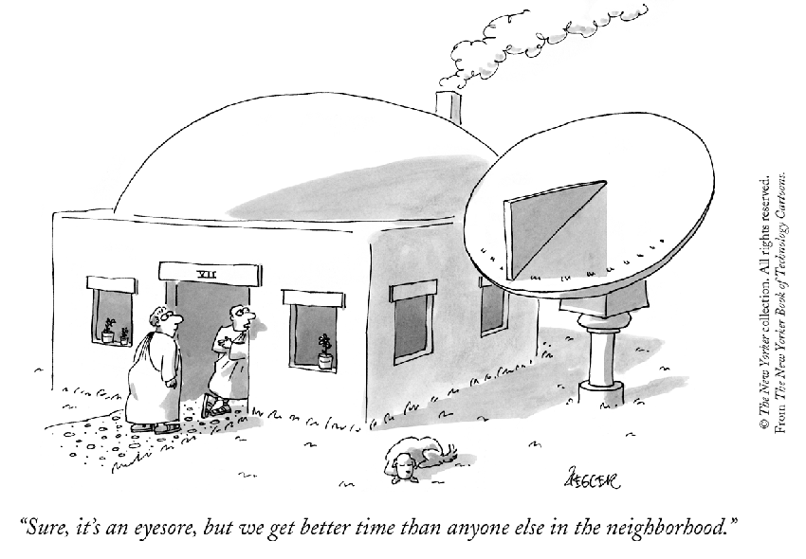
Sense of adventure?
Culinary Technology 110/ 120
Hospitality and Tourism 110
Do you possess a Sense of style and love of architecture?
Housing and Interior Design 120

Slide 10
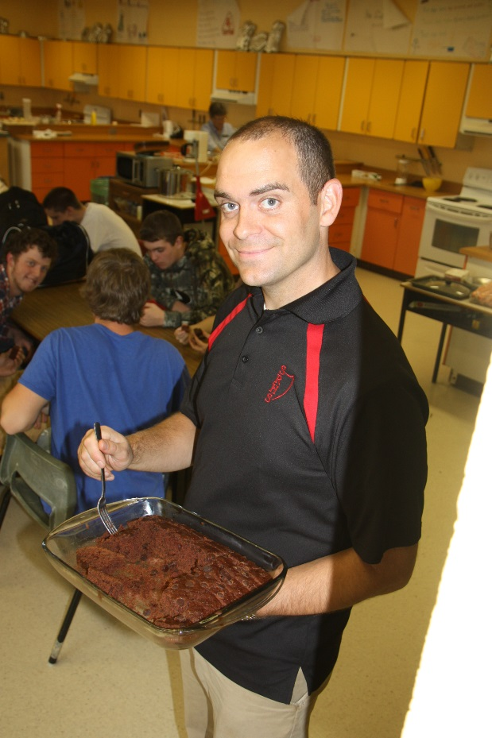
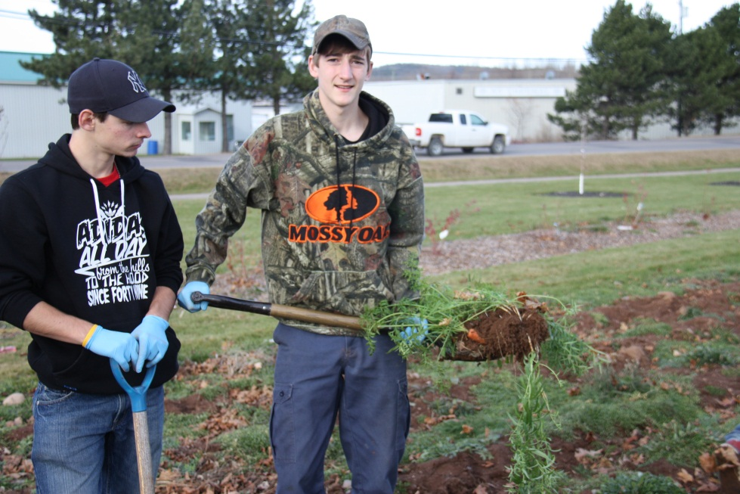
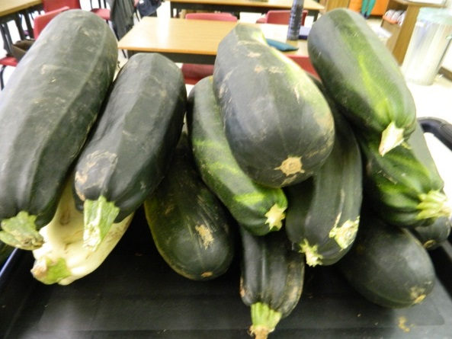
Would you like to learn more about the science of food.
Agriculture Science 120
Nutrition for Healthy Living 120

Slide 11
Still haven’t found what you are looking for? We’ve got Co-op Placements ☺
On the job experience
Job trends and career paths
Excellent opportunity to discover if a job is right for you.
Co-Op Education 120

Slide 12
What we can offer you!!!
Experiences in......
Carpentry and Woodworking The Electrical Trade
Automotive Industry Hospitality and Tourism
Agriculture Co-Op Opportunities
Culinary Accounting Welding/ Metals
Housing and Interior Design Early Childhood Services

Slide 13
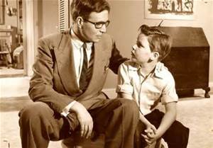
What to do now
Consider your interests
What are you already good at?
Talk to your parents
Talk to your older friends about courses
Visit the Workroom
Go online and see what the prerequisites are at the school you want to attend
Look at the course selection guide
Take a interest quiz
Utilize www.myBlueprint.ca/anglophonesouth
“Find something you love to do and
you will never have to work a day in your life”

Slide 14
If you are interested in a technical career or want to learn more about our courses, please reach out to a Guidance Counsellor or consult the Course Handbook on our website.
Mrs. Crystal Gray crystal.gray@nbed.nb.ca
Mrs. Carmen Meehan carmen.meehan@nbed.nb.ca

